Slide 1
HOTAL RESERVATION ANALYSIS
​BY: KHYATI TRIVEDI

Slide 2


Agenda
A
Introduction
Data Importation & Preparation
Problem statement
Conclusion

Slide 3
Introduction
In this project, I explored a hotel reservation dataset to identify interesting patterns and trends that could inform business strategies and decision-making.
The aim of this project was to work with a hotel reservation dataset that contains information about Hotel. The primary goal of the Hotel reservation analysis is to provide an integrated platform for managing various hotel activities.
It caters to both hotel managers and customers, offering features such as room booking, staff management, and other essential hotel services.

Slide 4
Data Importation & Preparation
The hotel reservation dataset in CSV format that contained information about hotel bookings. This dataset included details such as rice,weat.
I imported the hotel reservation dataset into MySQL environment.
I performed data cleaning tasks to handle missing values, duplicate records, and outliers, ensuring the dataset’s integrityal revenue growth

Slide 5
Problem statement
1.What is the total number of reservations in the dataset?
Total no. of reservation is 700.
2. Which meal plan is the most popular among guests?
Meal plan 2 is the most popular among guest.
3. What is the average price per room for reservations involving children?
avg. Price per room is 144.56
4. How many reservations were made for the year 2018?
29 reservation were made for the year 2018
5. What is the most commonly booked room type?
Room type 1 is the most commonly booked room type

Slide 6
6. How many reservations fall on a weekend (no_of_weekend_nights > 0)?
383 reservations fall on a weekend
7. What is the highest and lowest lead time for reservations?
443 is the highest and 0 is lowest lead time for reservation
8. What is the most common market segment type for reservations?
Online is the most common market segment type .
9. How many reservations have a booking status of "Confirmed"?
0 reservation have a booking status of confirmed
10. What is the total number of adults and children across all reservations?
adults is 1316 is and children is 69 across all reservation

Slide 7
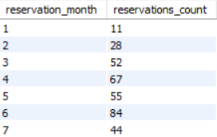
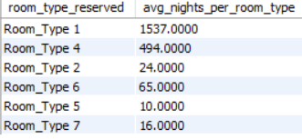
11. What is the average number of weekend nights for reservations involving children?
1.00 is the avg. number of weekend nights for reservation involving children
12. How many reservations were made in each month of the year?
13. What is the average number of nights (both weekend and weekday) spent by guests for each room
Type?
14. For reservations involving children, what is the most common room type, and what is the average
price for that room type?
Room type 1 is the most common room type and 123.12 is avg. price for that room type.
15. Find the market segment type that generates the highest average price per room.
Online market segment type that generates 112.45 highest avg. price per room.

Slide 8
conclusion
By analyzing booking trends, we observe peak seasons and off-peak periods. This information can guide pricing strategies and resource allocation.
Understanding which channels (direct bookings, online travel agencies, etc.) guests prefer helps optimize marketing efforts and distribution channels.
Segmenting guests based on demographics, preferences, and behavior enables personalized marketing and service delivery.
Dynamic pricing based on demand, seasonality, and competitor rates can maximize revenue.

Slide 9
Thank you
Khyati Trivedi
khyatinagar96@gmail.com

